Slide 1
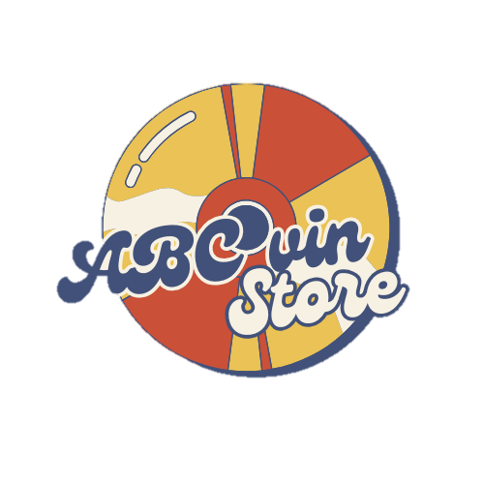
Dynamic Consulting Company
Anna Do, Patrick Hayden, Grace Saddler, Ava Scotchie

Slide 2




Meet the Team
Anna Do
Patrick Hayden
Grace Saddler
Ava Scotchie
Junior Business Information Systems major from Vietnam
Junior Business Information Systems major from Chicago, Illinois
Junior Accounting and Supply Chain Value Management major from Fort Worth, Texas
Junior Supply Chain Value Management and Finance major from Chattanooga, Tennessee

Slide 3




Company: Doc’s Records
Fort Worth, TX
Family-Owned
Operates a physical store and online store
Sells Vinyl, CDs, Cassettes, Tracks, and other Vintage Items
Notes:
These are a few key attributes about your company that went into our recommendations for software

Slide 4
Current Business Operations
Strengths:
Large retail shop of 10,000 square feet
Website that lists most inventory items
Weaknesses:
Employees manually input inventory when items arrive to the store or are purchased
Manual updates to inventory on website
Unavailable items presented on website
No place for customer feedback or preferences
Notes:
Add plus or minus depending on positive or negative or reorder these into strengths and weaknesses

Slide 5
Opportunities
Automation of Inventory Updates and Real-Time Visibility
Switch from manual to perpetual system
Maximize sales and enhance customer satisfaction
Streamlined Processes
Redirect employee focus to improve productivity
Error Reduction
Automated updates reduce discrepancies and potential human error
Notes:
Restructure or add more space

Slide 6
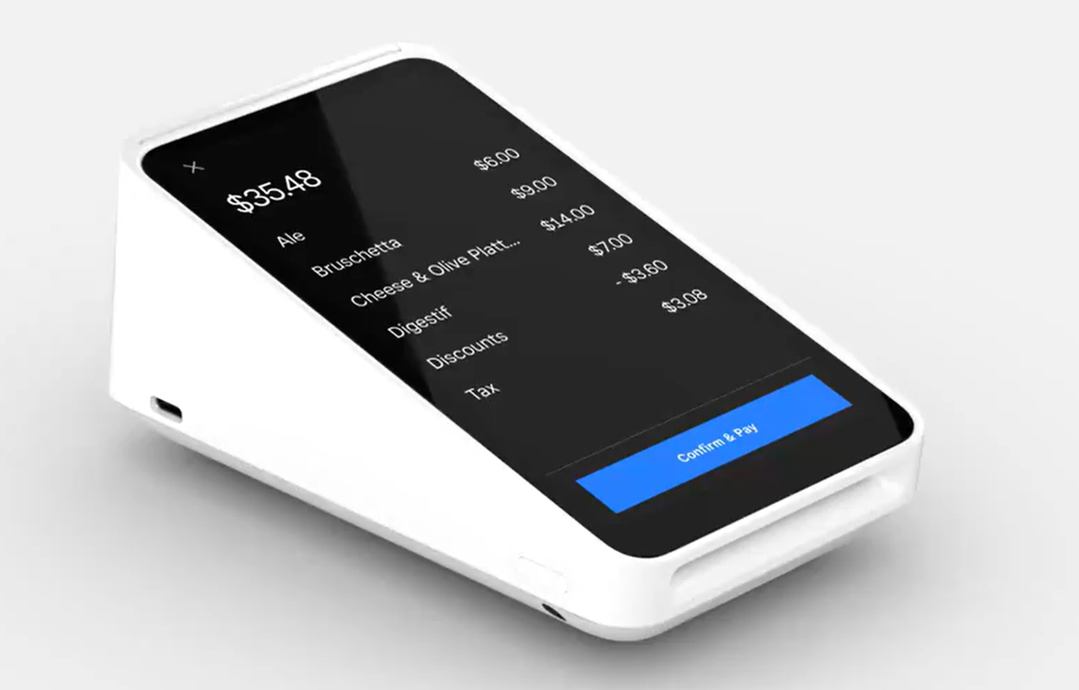


Improved Operations Proposal
Cloud Based Software: Square
Real-Time Inventory Updates
Customer Relationship Management
Accurate in-store and online inventory
Employee efficiency
Improved customer satisfaction
Customer feedback and preference
Personalized marketing techniques
Notes:
Add interface of square – a little pic?

Slide 7
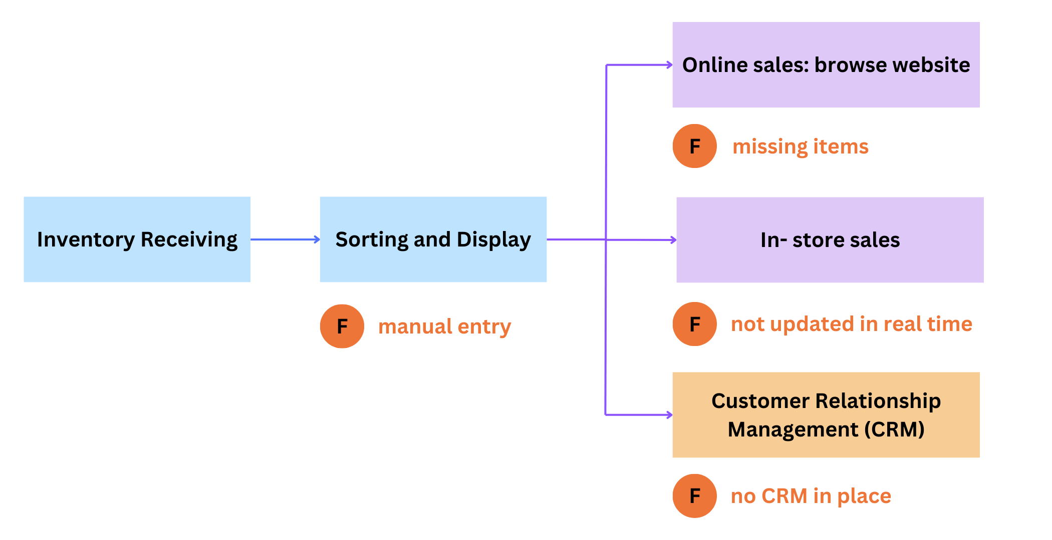
Current Business Process Model
Notes:
Somehow make this easier to see

Slide 8
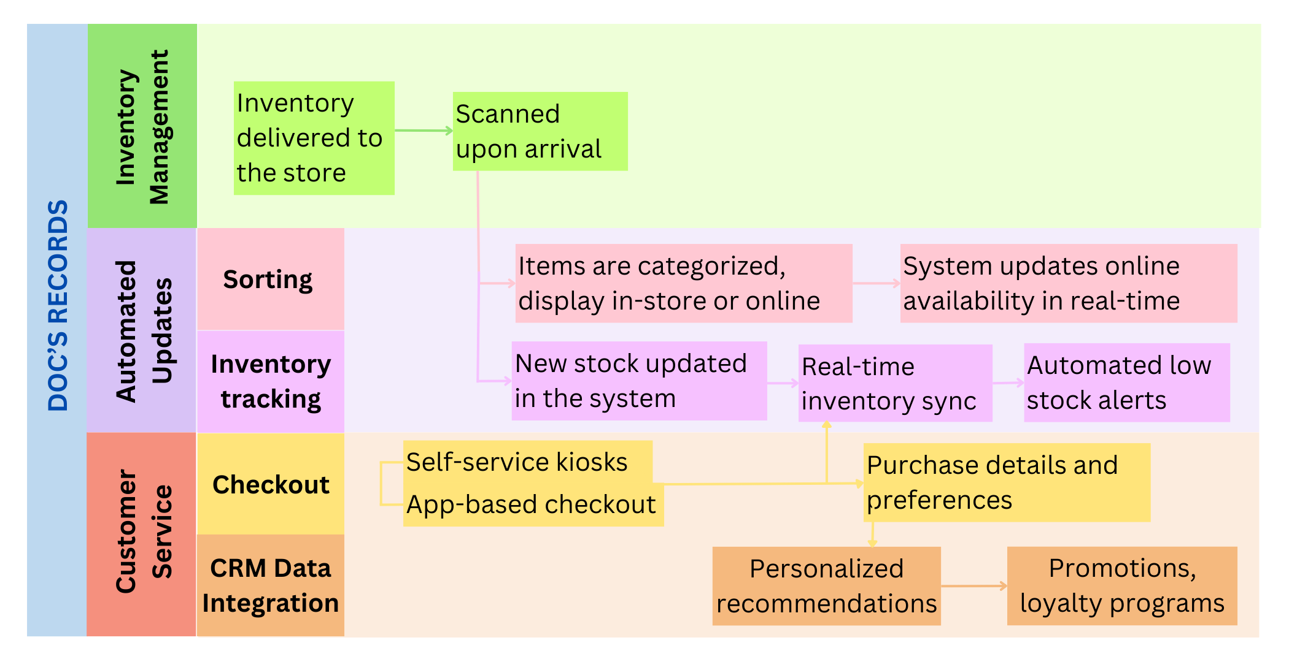
To-Be Business Process Model
Notes:
Quickly go over

Slide 9
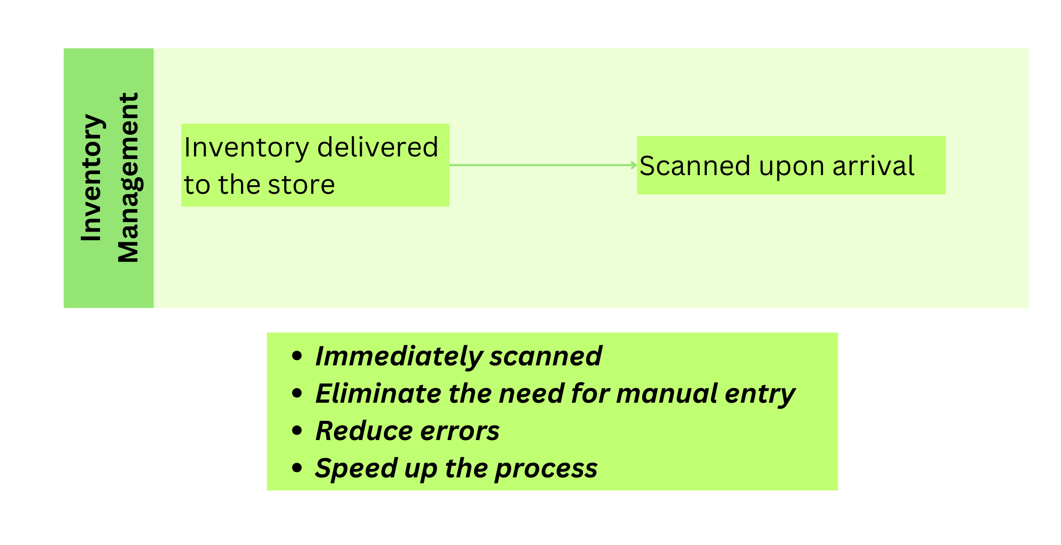
Key Improvements

Slide 10
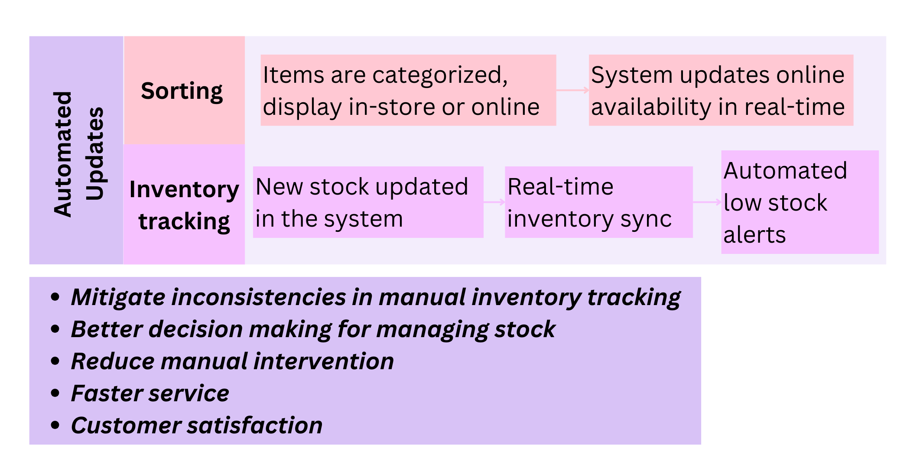
Key Improvements
Notes:
Captial U and Captial T on Inventory Tracking

Slide 11
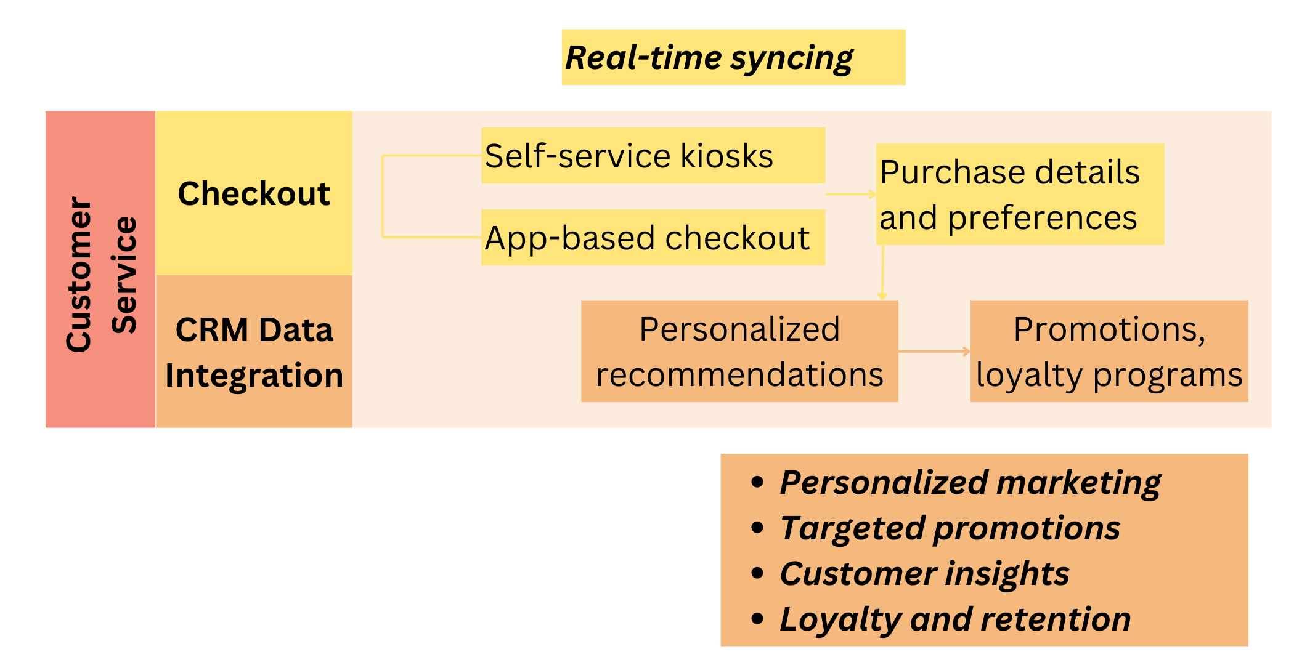
Key Improvements

Slide 12


Slide 13


Risks
Disrupted Operations
Employee Resistance
Security Breaches
Implementation time
Employee training and onboarding process
Employees may resist software change
Possibility for human errors
Cloud based software is at risk for potential security breaches
Notes:
Inventory tracking can fall behind, in store implementation can cause delays with purchasing

Slide 14
Mitigation of Risks
Disrupted Operations: phased rollout of software
Employee Resistance: involve employees early on in the process of implementation
Security Breaches: apply regular security updates to software, train employees on breach scenarios for quick response time
Notes:
Spacing

Slide 15
Dynamic Consulting Company
Notes:
End with something like: "We appreciate you taking the time to listen to our presentation. We are excited about the opportunity to collaborate with you and look forward to hearing from you soon."

